Slide 1
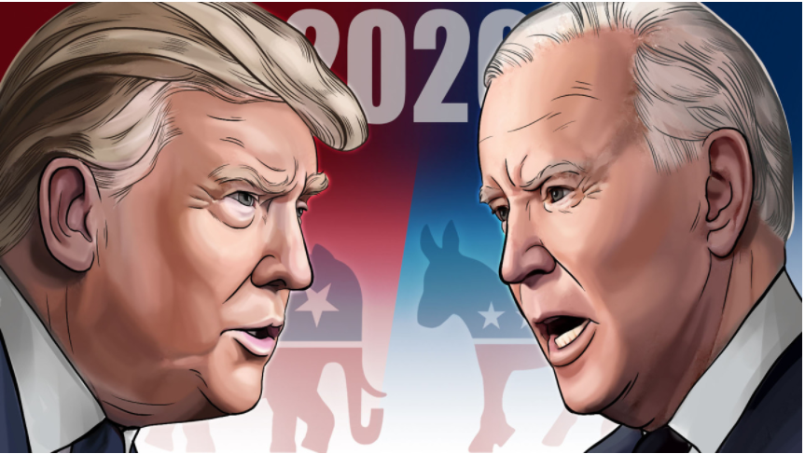
Text Mining
Instructor : Peng Xie
1
Twitter Data Analysis of 2020 elections presidential Candidates
Group 10
Devi Nadimpally (yy4246)
Priyanka Shah (mt8964)
Uttara Dabbiru (py4642)
Venkat Narayanan (fz2722)
Date : May 4th 2021

Slide 2
Project Background
2
The prediction of the United States presidential elections attracted a great deal of attention from researchers to try and predict electoral results.
Held in the backdrop of the COVID-19 pandemic and amid various protests raging across the country, considering the various racial discrimination issues, the election was one of the most important events that was widely anticipated and analyzed by various people across the globe.
Choosing the president involves different factors for consideration. Presidential tweets is one good factor to understand the public mood and opinion in different US states towards the candidates

Slide 3
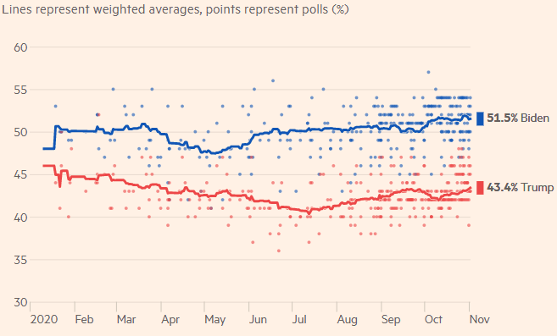
Project Objective
3
The goal of this project is to observe, analyze and predict the social influence of the presidential candidates, based on their regular social activity on the popular media platform, Twitter.
With the help of various text analysis methods, such as Sentiment analysis, Topic modeling, Sophistication measure, a Negative Binomial Model is built to predict the social engagement trends and provide insights regarding the candidates.
Resource: https://ig.ft.com/us-election-2020/polls/

Slide 4
Project Flow
4
Text Extraction
Text Preprocessing
Explanatory Features
Conclusion
Negative Binomial Model

Slide 5
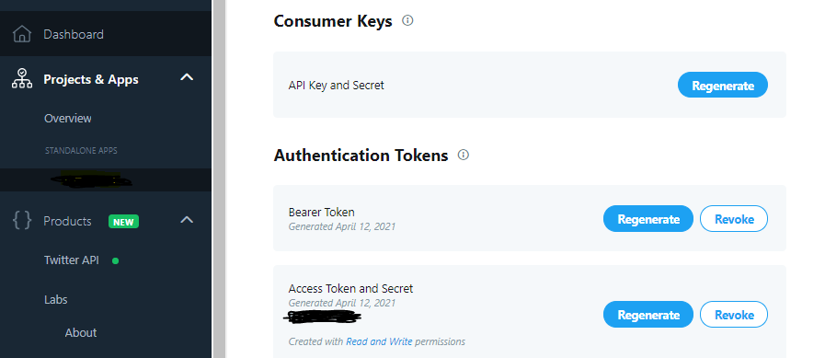
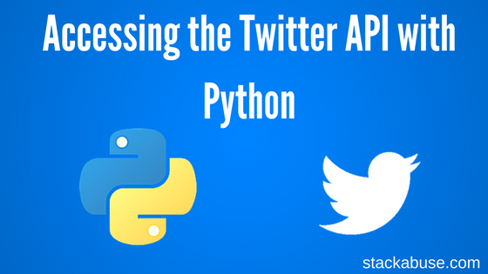
Text Extraction
5
Generated the API keys using Twitter Developer Portal and used ‘Tweepy’ library in python to establish connection with twitter
Extracted the ID, Date, Tweets, Like count , Reply count, Retweet count by using ‘snscrape’ library.

Slide 6
Data Description
6
Feature | Description
ID | Integer variable that refers to the twitter unique ID
Date | String variable that refers to the tweet date
Tweets | String variable that refers to the tweets of presidential candidates
Reply count | Integer variable that refers to number of replies for each tweet
Retweet count | Integer variable that refers to number of retweets for each tweet
Like count | Integer variable that refers to number of likes for each tweet
1814 records

Slide 7
Text Pre-processing
7
Merge Biden and Trump Tweets
links, usernames, emojis, punctuations
Word Tokenization
Stop words
Stemming
Zero Length Tweets

Slide 8
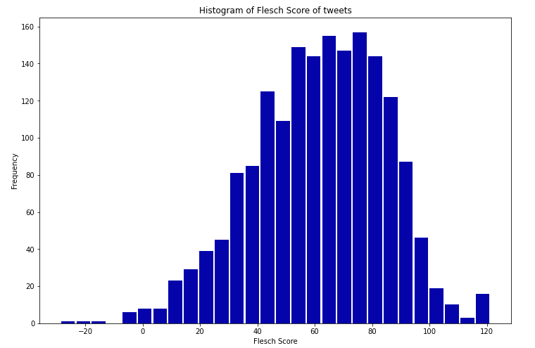
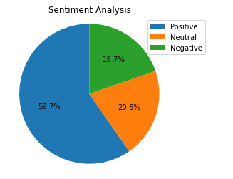
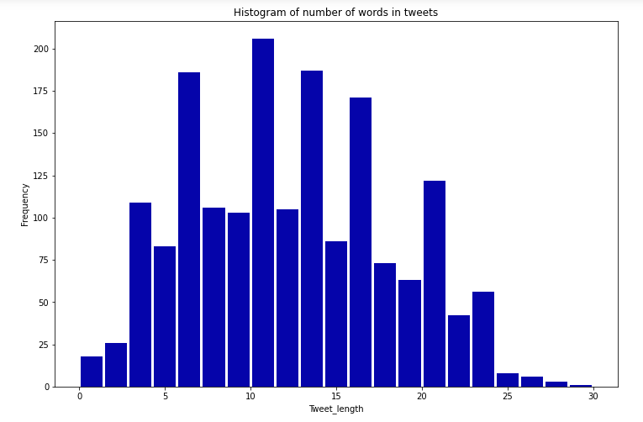
Explanatory Features
8
Sophistication Measure
Sentiment Analysis
Length of the Tweets
Higher number of tweets are with medium Flesch score.
FRE = 206.835 − 1.015*(total words/ total sentences) − 84.6 * (total syllables/ total words)
59.7% of the tweets are positive
Negative tweets are lesser
Higher number of tweets are of tweet length between 11-15 words

Slide 9
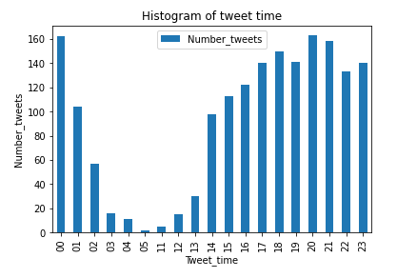
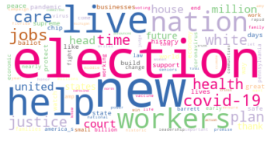
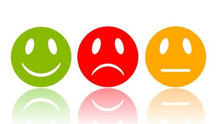
Explanatory Features
9
Hourly Tweets
Topic Modelling
Lexicon Sentiment Analysis
Higher number of tweets are tweeted between evening to mid night of the day.
Most frequent word used by the candidates is ‘Election’.
Implemented LDA and gathered 25 topics.
Strong
Weak
Hostile
Pleasure

Slide 10
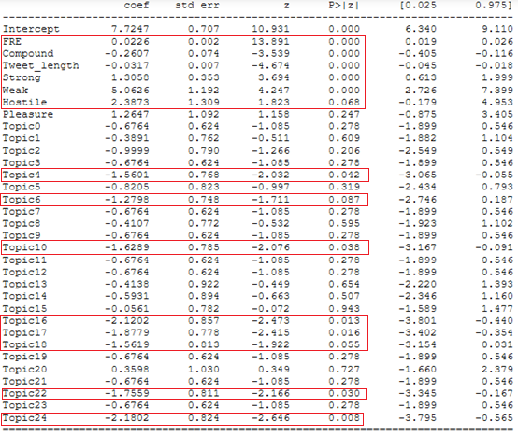
Negative Binomial Model
10
Negative binomial regression is for modeling count variables, usually for over-dispersed count outcome variables.
This model which is ideal for predicting count value uses explanatory features, including topic and emotion of the tweets in order to predict the count of replies, likes and retweets.
Significant variables have been identified based on
p-value.

Slide 11
Observations and Conclusions
11
Features | Reply Count | Like Count | Retweet Count
Sophistication | High | High | High
Tweet length | Low | Low | Low
Sentiment | Low | Low | Low
Strong | High | High | High
Weak | High | High | High
Hostile | High | High | High
Higher Sophisticated Tweets and Strong, Weak, Hostile emotions tweets are highly influential and tend to grab more public attention

Slide 12
Observations and Conclusions
12
Topics | Reply Count | Like Count | Retweet Count
Inaugural Speech | High | Low | -
Economy | Low | Low | -
Violence | Low | Low | -
Judge Nomination | Low | Low | -
Small Businesses | Low | Low | -
Covid-19 | Low | Low | Low
Vaccines | - | High | High
Frontline Jobs | Low | Low | -
Military | Low | Low
Topics Inaugural Speech and Vaccines are highly influential and grabbed more public attention

